Slide 1
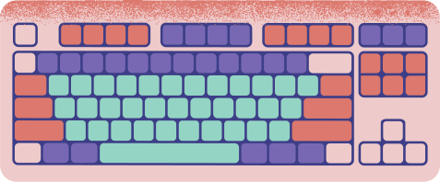











INTERNSHIP TASK-1
CREATING A DATABASE
BY. ANNU JHA

Slide 2





what is database?
A database is an organized collection of structured information, or data, typically stored electronically in a computer system. A database is usually controlled by a database management system (DBMS).

Slide 3

Steps to create a new database in SQL

Slide 4
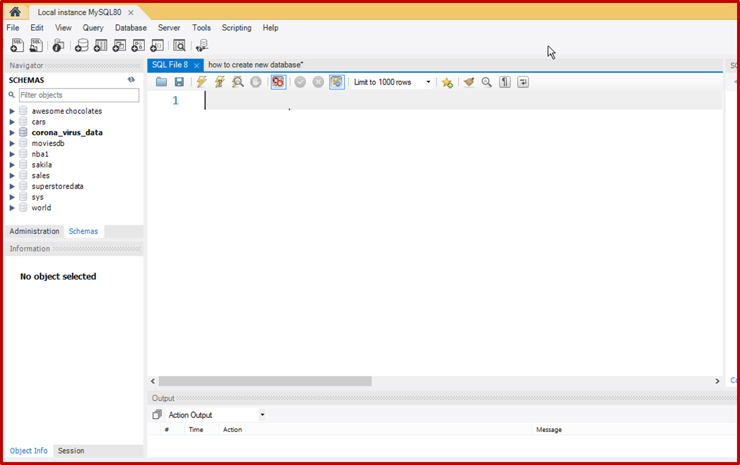

TO CREATE A DATABASE, FIRST OPEN MYSQL WORKBENCH.

Slide 5

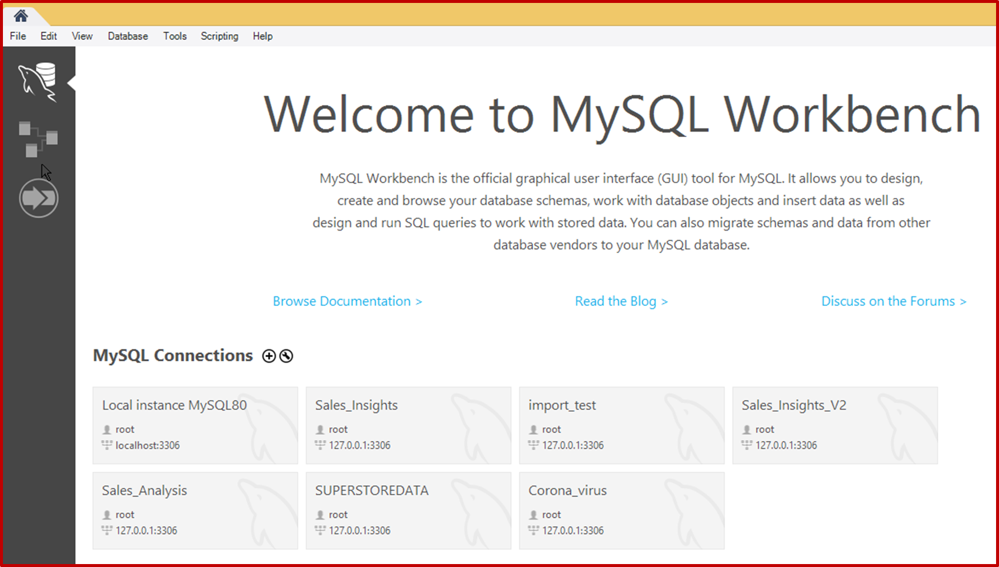



Connect to Database Server

Slide 6

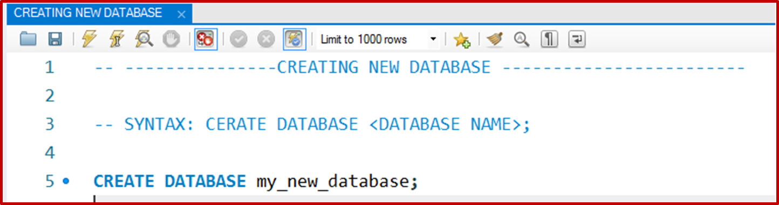
Write SQL Query in query editor AND EXECUTE IT BY CLICKING ON
RUN BUTTON

Slide 7
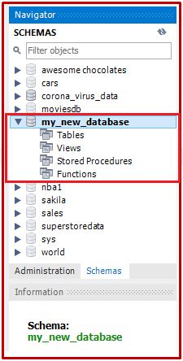
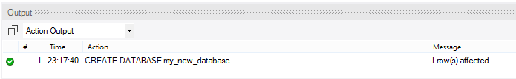
TO Verify Database Creation SEE OUTPUT
SECTION AND Check the left sidebar to see
the new database under 'Schemas'.

Slide 8
Thanks for
playing!

